Slide 1
Mobile Application Development
Games Academy June 2015 - Day 3
Benjamin Nitschke - Delta Engine

Slide 2
Recap of Day 1
Quick overview of platforms
Focus on Windows 8 and Windows Phone
Usage of DirectX and C++
Created Universal App to work on both devices
ARM, x86, x64
Shared code and assets
Textures, Sprite rendering, Xaml setup, Touch Input
Testing and deploying on W8 & Windows Phone
Windows Store Details

Slide 3
Recap of Day 2
Linux platform primer
Installing Ubuntu on VirtualBox
gcc compiling and terminal commands
Android platform overview
Android Studio IDE and Java
Usage of OpenGL ES
Created Android Landscape mode SpaceInvaders
GL Textures, Sprite rendering, Touch Input
Testing and deploying on Emulator and Android Devices
Windows Store Details

Slide 4
Onto the platform for the rich
Day 1: Platforms Overview
Windows, Windows 8, Windows Phone
Visual Studio: C++, C#
Day 2: Open Source Platforms
Linux, Android
Gcc: C++, Eclipse, IntelliJ: Java
Day 3: Apple Platforms
MacOSX, iOS
XCode: Objective-C
Notes:
Bye bye Windows, this time for realz, no way we can use XCode on Windows.

Slide 5
Mac OSX
There are only two choices
Buy a Mac (expensive, cheapest choice: MacMini)
Try Hackintosh (time consuming, need extra PC)
Install XCode
It’s free
Supports Objective-C and Swift
Also can be used for C++ and other languages
Most of the Linux commands work here too
Keyboard commands are also a bit strange
Notes:
Also show tools, workflow with Synergy, VNC, Remote, etc. If there is time at the end we can also check out Unity on Mac

Slide 6
Let’s compile with gcc
Gcc (for C) and g++ (for C++) are available
Just open a Terminal like on Ubuntu
Create a simple text file, compile and run it
cat > test.cpp
#include <stdio.h>
int main() { printf(“Hi there\n”); } (Ctrl+D to close file)
g++ test.cpp -o test
./test
Notes:
http://www.network-theory.co.uk/docs/gccintro/gccintro_9.html
Also see my C++ course for a text adventure: https://github.com/BenjaminNitschke/CppCourse/tree/master/Day1
The Terminal is called bash on Mac. While very powerful most people will not use it and mostly do simple stuff like cmd on Windows.

Slide 7
Objective-C
Similar to C and C++ syntax
but has Smalltalk like messaging, which makes it look strange to normal C++/C#/Java programmers
- (int)method:(int)i { return [self square_root:i]; }
- (int)changeColorToRed:(float)red green:(float)green blue:(float)blue; [myColor changeColorToRed:5.0 green:2.0 blue:6.0];
Notes:
Good comparison to C++: http://stackoverflow.com/questions/2445050/how-different-is-objective-c-from-c

Slide 8
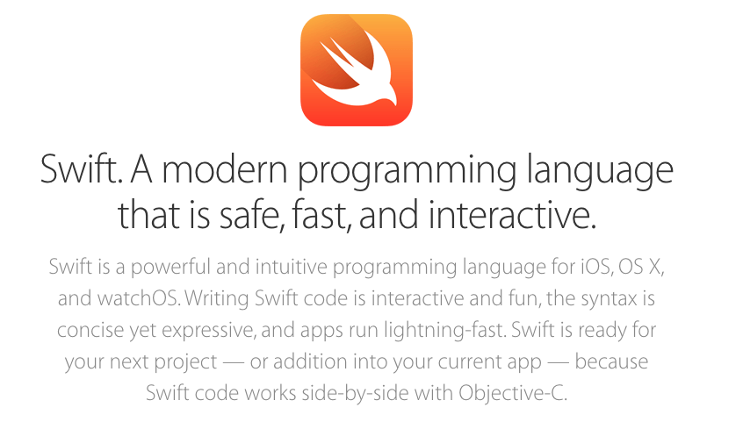
Swift
Notes:
https://developer.apple.com/swift/

Slide 9
Swift
C like syntax
Influences from Python
Compatible with Objective-C code
Uses Curly Braces
Semicolons are not needed
var str = "hello," str += " world"
Notes:
https://developer.apple.com/swift/

Slide 10
Swift example code
// Swift variables are declared with "var" this is followed by a name, a type, and a value var explicitDouble: Double = 70 // If the type is omitted, Swift will infer it from the variable's initial value var implicitInteger = 70 var implicitDouble = 70.0
// Swift constants are declared with "let" followed by a name, a type, and a value let numberOfBananas: Int = 10 // Like variables, if the type of a constant is omitted, Swift will infer it
let numberOfApples = 3 let numberOfOranges = 5 // Values of variables and constants can both be interpolated in strings as follows let appleSummary = "I have \(numberOfApples) apples."
// Functions and methods are declared with the "func" syntax, return type is specified with -> func sayHello(personName: String) -> String { let greeting = "Hello, " + personName + "!" return greeting } print(sayHello("Dilan"))
Notes:
https://en.wikipedia.org/wiki/Swift_(programming_language)

Slide 11
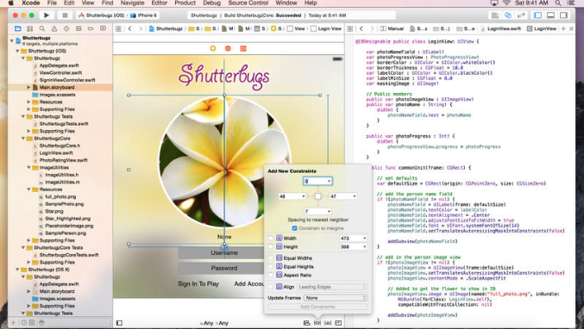
XCode
Notes:
Android may be based on Linux, but it’s not based on the type of Linux system you may have used on your PC.
http://www.howtogeek.com/189036/android-is-based-on-linux-but-what-does-that-mean/

Slide 12
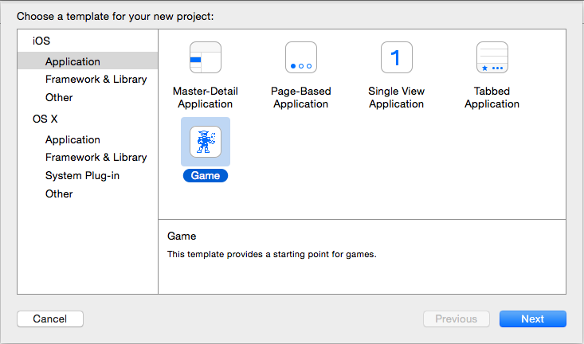
XCode Create Project

Slide 13
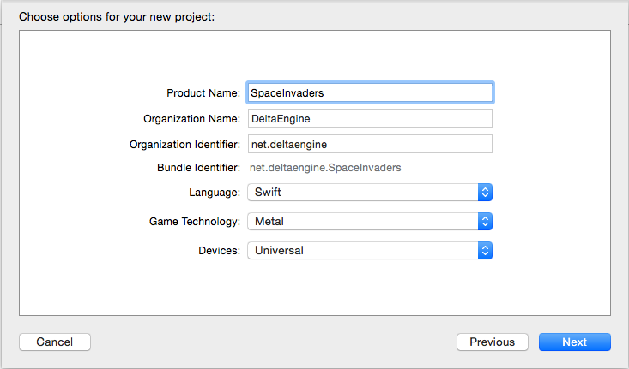
XCode Project Settings
Notes:
We can choose OpenGL ES, but this is not finished in Swift and won’t work, probably never will be really supported. Welcome to the world of Apple development ..
Metal is however an interesting framework and good for our little example game.

Slide 14
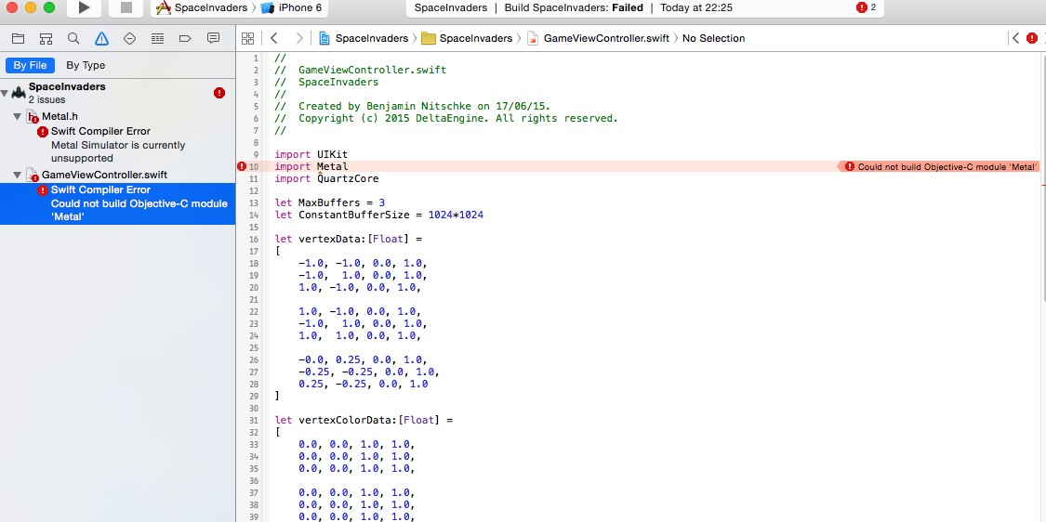
XCode Swift OpenGL and Metal
Notes:
Nothing works out of the box, bleeding edge .. and Swift has been out for over a year ..

Slide 15
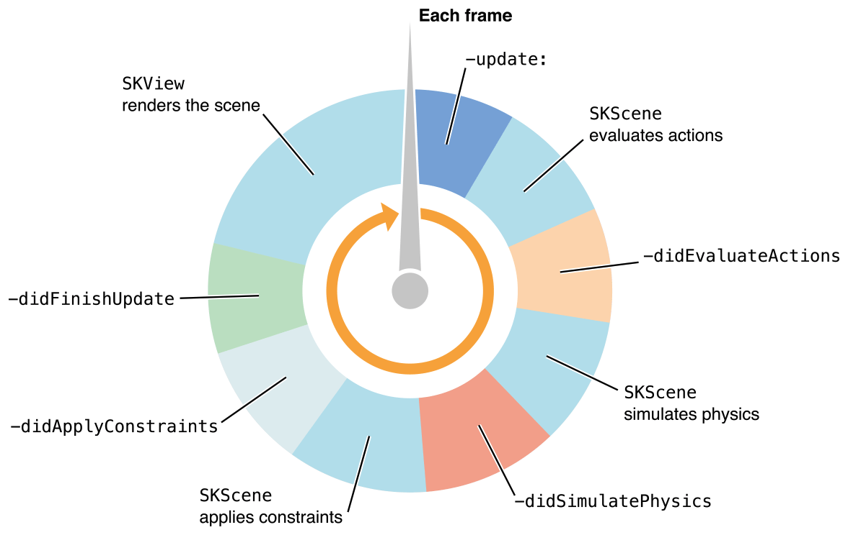
SpriteKit
Notes:
There are two more options, which work, but are more for normal apps or very simple games. SpriteKit is still good enough for us.
If there is time we will take a deeper look at OpenGL ES with Objective-C later.

Slide 16
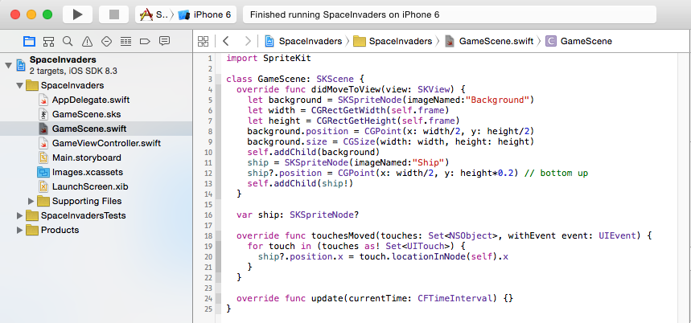
Background and Ship

Slide 17
Live Coding
Rest of the SpaceInvaders Game
Based on the same code as previously used
https://github.com/BenjaminNitschke/CppCourse/Day2
Next steps
Convert all game logic to Swift
Fight with the compiler
Find best machting classes and structs
Test and improve

Slide 18
Apple Developer Tour
To release the finished game in the App Store
Apple Account is needed
Sign in and join the Apple Developer Center
https://developer.apple.com/membershipcenter/index.action
Pay $99 Registration Fee (for a year)
Create certificate and sign your app
Upload app to Store, set price, etc.
For testing you still need an account and need to add your devices (limited to 100), much more restricted than Android
Notes:
Going though this will take more time

Slide 19
Questions?
All code and these slides are available at:
https://github.com/BenjaminNitschke/MobileCourse
Notes:
If there is time and interest, show Unity on Mac OSX for deploying something on iOS. Same concepts apply, we just won’t code in Swift or Objective-C.

Slide 20
Links
http://www.apple.com/osx/
https://developer.apple.com/
https://en.wikipedia.org/wiki/Objective-C
http://www.apple.com/swift/
http://www.learnswift.tips/
https://en.wikipedia.org/wiki/Swift_(programming_language)
http://stackoverflow.com/questions/2445050/how-different-is-objective-c-from-c
https://developer.apple.com/programs/

